Slide 1
Data Science + Design Thinking: a perfect blend to achieve the best user experience
AI Conference SJ 2019
Michael Radwin
Vice President, Intuit
Notes:
Hey everyone. It’s great to be here at the O’Reilly AI conference!
My name is Michael Radwin. I’m a Data Science & Analytics leader at Intuit.
I’m super-excited to share a few stories with you about how we applied design thinking to AI product development at Intuit.
I hope you’ll take away some new techniques you can apply at your own organizations.

Slide 2
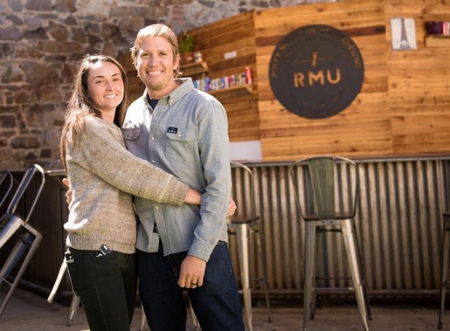
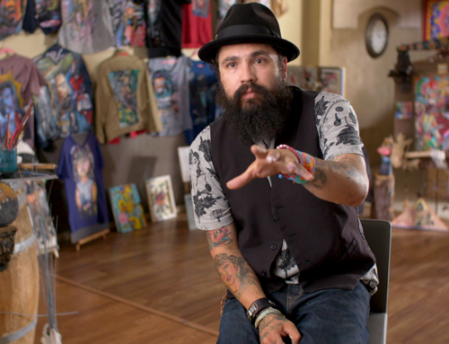
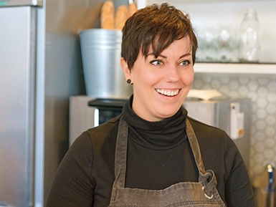
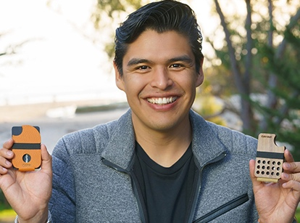
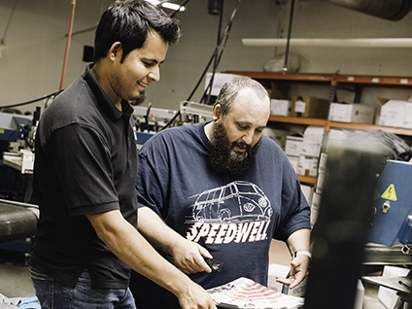
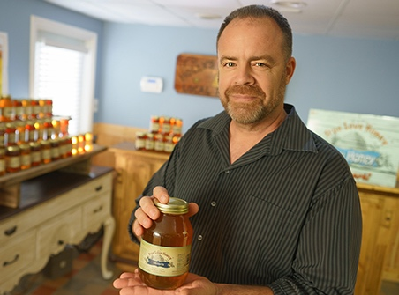
Who we serve:
Consumers
Small businesses
Self-employed
Notes:
We'll start with some audience participation. Can I get a show of hands? How many of you love doing your taxes? ... Right. Not too many hands went up.
Yes, Accountants love the intricacies of taxes. And the rest of us? Well, taxes are something that are REQUIRED but not DESIRED. This is true of many tasks in the financial industry.
At Intuit we've been building financial software for the past 35 years, powering the prosperity of consumers, small businesses, and the self-employed.
You might even have used one of our products… TurboTax, QuickBooks, or Mint.

Slide 3
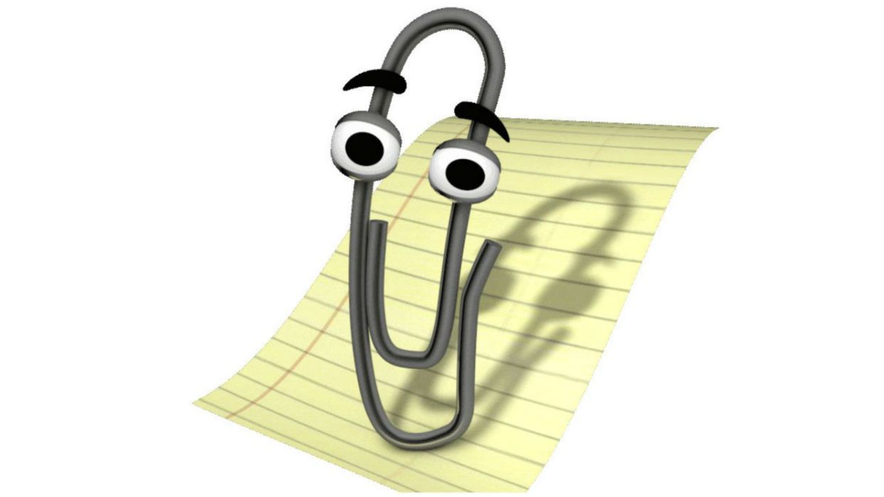
Great AI, bad design
Notes:
How many of you remember Microsoft Clippy?
The artificial intelligence behind Clippy was actually quite sophisticated for the late 1990s. But their user experience left something to be desired.

Slide 4
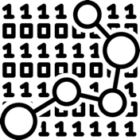
Data science vs. design mindsets
MODELS
LABELS
PRECISION/RECALL
AUC
K-MEANS
HYPER-PERAMETER TUNING
3-CLICK RULE
GOLDEN RATIO
F-SHAPED PATTERN
WIREFRAME
CARD SORTING
HEATMAP
Notes:
Great data scientists work at the intersection of math & statistics and software engineering.
Great designers bring creativity and aesthetic sense, and also deep understanding of users and customers and the problems they face.
Each discipline - data science and design - brings its own language and mindset.

Slide 5
How can we come together?
Notes:
So, how do data scientists and designers come together?

Slide 6
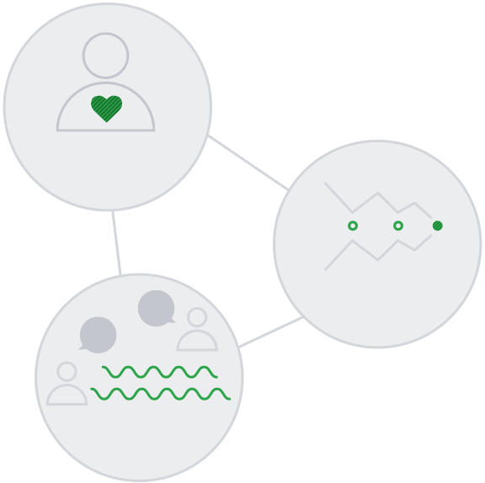
Solution: Design for Delight
Deep customer empathy
Go broad to go narrow
Rapid experiments with customers
Notes:
Design for Delight, aka D4D, is a methodology that we use to innovate at Intuit.
It’s a simplified approach to what the Stanford University d.school calls Design Thinking. It’s a technique you can use for creative problem solving.
We teach Design for Delight to our teams at Intuit so they can better deliver dramatic improvements in our customers’ lives. D4D helps our teams develop better solutions that evoke positive emotion throughout the customer experience.
D4D has 3 components: deep customer empathy... We’ll explain more about each of these 3 parts.

Slide 7
Empathy
Knowing customers better than they know themselves
Deep customer empathy
Delight
Go broad to go narrow
Rapid experiments with customers
Notes:
Principle #1: Deep Customer Empathy
Empathy allows us to get inspired and embrace the unexpected.
We start by getting deeper understanding of our customer, and understand what our customer's pain points are.
This means observing and engaging with customers to get an unfiltered view of their challenges … ideally in their own natural habitat.
With deep customer empathy, design thinkers naturally begin to set aside their own biases and assumptions.
We begin to define the problem we’re trying to solve in human-centric terms, rather than framing it in technology-centric or company-centric terms.
This gives us that inspiration to innovate and come up with solutions to change the customer's life so profoundly that they can’t imagine going back to the old way of doing things.

Slide 8
Deep customer empathy
Broad to narrow
Iterating your way to the answer
Go broad to go narrow
Rapid experiments with customers
Notes:
Principle #2: Go Broad to Go Narrow
Only after gathering, analyzing, synthesizing and defining the customer problem, can we begin to look for solutions.
This phase in the process is all about stimulating free thinking, expanding the problem space, and generating lots of ideas for exploration
To get to one great idea, you need a lot of them.
The trick is to go for quantity first, then be intentional about narrowing these down to the best one.

Slide 9
Deep customer empathy
Go broad to go narrow
Rapid experiments
Getting tangible and learning from customers quickly
Rapid experiments with customers
Notes:
Principle #3: Rapid Experiments with Customers
Rapid experiments help you make better decisions based on actual user behaviors.
Decisions are better based on facts than conjecture; experiments are usually the best way to get the facts.
Experiments can help you discover the truth before you build.
Experiments help teams align on the customer.
This is the point where we begin rapid prototyping and A/B testing.
By putting prototypes into the hands of actual customers, we can see whether people behave, react, and respond the way we expected. And, we can find opportunities to do better with the next build.
Rapid experiments keep our project rooted in the real world.

Slide 10
Design for Delight
Method 1: Follow-Me-Home
Method 2: Customer Problem Statement
Deep customer empathy
Method 3: Brainstorming
Method 4: 2x2 Narrowing
Go broad to go narrow
Rapid experiments with customers
Method 5: Leap of Faith Assumptions
Method 6: Paper Prototyping
Notes:
So those are the 3 principles. Deep customer empathy, go broad to go narrow, and rapid experiments with customers.
These 3 principles are easy to learn, but require some discipline to put into practice.
We've shared a booklet with with you today that contains several “method cards” to help you use Design for Delight at your own organization.
(build) Over the next few minutes, we’ll go deeper into some of the D4D methods in the context of how they were used to create awesome AI product experiences.
For example, identifying Leap of Faith Assumptions will help you to design and run the most important experiments first, so you can either validate or invalidate your hypotheses.

Slide 11
Examples of design thinking applied to Intuit’s data science product features
Notes:
Now that you’ve got a brief introduction to Design Thinking, let’s look at three examples of how we have applied the Design for Delight methodology to the space of AI & Machine Learning.

Slide 12
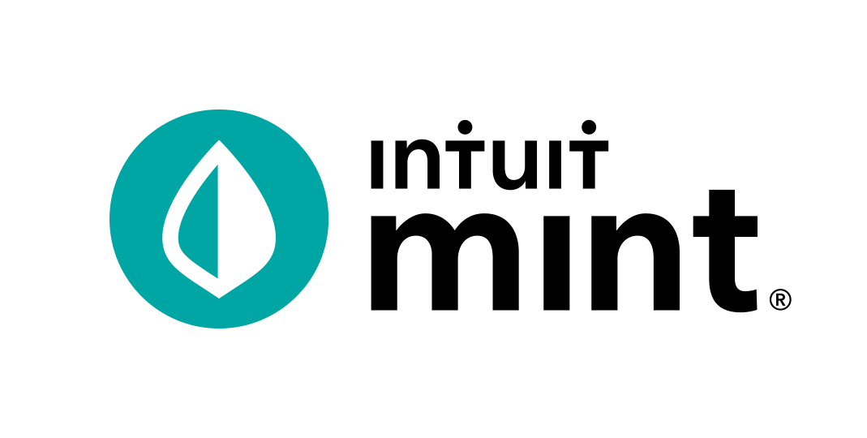
Mint Overdraft Prediction
Notes:
Our first example of blending data science and design for delight comes from Mint.
TARGET TIME:

Slide 13
Problem:
Americans pay billions of dollars in overdraft fees every year when they have insufficient funds.
50% of those fees are for transactions totaling less than $50.
The average overdraft fee is $35.
It’s hard for people to get ahead.
Notes:
From analyzing Mint transaction data, our teams found that many Mint users pay overdraft fees to their bank when they try to make a purchase but have insufficient funds in their bank accounts.
Mint customers are paying $250M a year in overdraft fees to just the 5 largest banks.
These fees are often $35.
Imagine a $3 a cup of coffee that turns into a $38 cup of coffee.
In fact, we find that half of these overdraft fees are triggered by transactions less than $50.
If you're living paycheck to paycheck, these overdraft fees can be a huge financial burden.

Slide 14
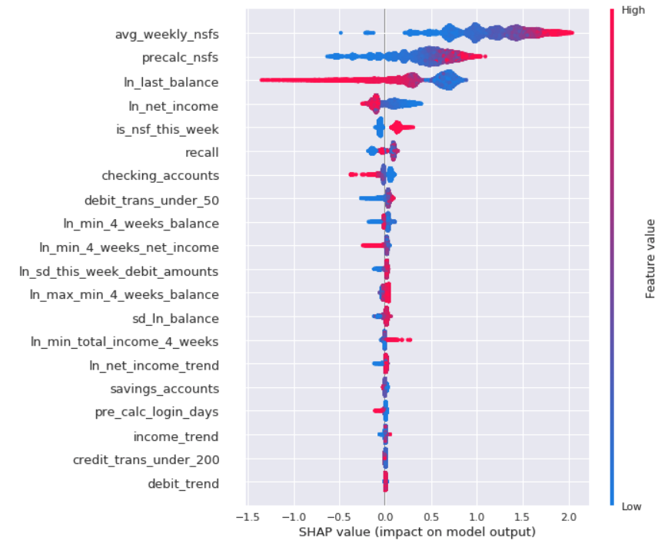
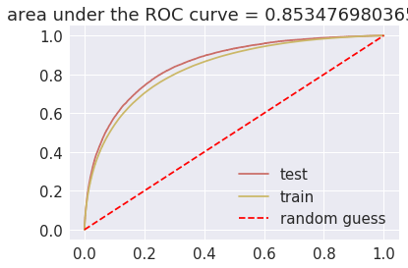
We built a supervised ML model to predict overdraft
Notes:
So, we set out to help Mint users avoid paying overdraft fees.
We created a supervised ML model to predict the likelihood that the user will overdraft their checking account.
Our gradient boosted tree model uses transaction and balance data from the past month.
To instill confidence, we knew it would be critical to excel in Prediction Accuracy and Timeliness.
In the classic precision-recall tradeoff, we chose to optimize for high precision.
Then, once we have a prediction, we send alerts far enough in advance so our users can take some action to avoid overdrafting (e.g. transfer/deposit/borrow money)
Extra material (not talk track):
#1 – Prediction Accuracy
Our goal was to develop a model with high precision, choosing precision over recall.
We analyzed transaction and balance data (types of accounts, and transactions, balance totals and fluctuations, etc.).
We gained a deep understanding of circumstances that would most likely result in an overdraft, then trained the models to predict overdrafts under various conditions.
#2 – Timeliness
We knew that affecting change would take much more than a great AI model.
We needed to alert users in a timely manner via the right channel(s).
Through data analysis and experimentation, we learned that email alerts would be most effective for Mint users.
We trained the model to predict overdraft at least one week in advance.
This would give our customers sufficient time to take action to avoid overdraft charges: transfer/deposit/borrow money.
#3 – Messaging effectiveness
To engage users and drive behavior change on such a sensitive financial matter, it was vital for our team to be grounded in deep customer empathy.

Slide 15
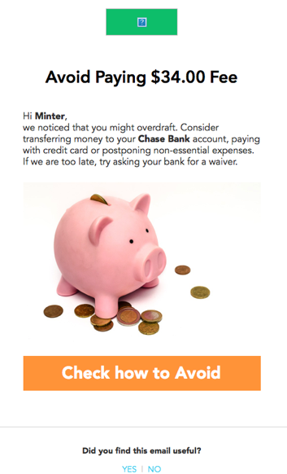
Mint customers have saved nearly $1M in overdraft fees over the past 12 months.
The overdraft prediction service sent more than 650K alerts to help users avoid paying non-sufficient funds fees.
Before
After
Avoid overdrafting your Bank of America account by taking
action
Notes:
We built a great model. But that wasn't enough.
Through rapid experimentation, we learned that the design of the experience had a huge impact on whether the users took action or not.
We needed simpler, shorter text, and
And a clear call to action
We even used a Behavioral Economics principle called Loss Aversion.
(build) The results are impressive. We've saved Mint users about $1 million in the past year.
AND... Better design led to a bigger improvement than a more accurate model. When prompted in the right way, we see that users are incurring HALF as many overdraft fees.

Slide 16
D4D Method: 2x2 Narrowing
Narrowing is about making decisions with intention. It’s not about reaching consensus on the easiest idea to implement or voting for your favorite.
Notes:
I’ll share a bit more about 2x2 Narrowing, one of the Design for Delight methods that the Mint Overdraft prediction team used.
In ”Go Broad to Go Narrow”, narrowing is about making decisions with intention. It’s not about reaching consensus on the easiest idea to implement or voting for your favorite.
There are a handful of tools to help teams narrow, but a 2x2 is probably the most accessible and effective.
First, during brainstorming, each member of the team writes down multiple ideas, one each on its own Post-It note

Slide 17
D4D Method: 2x2 Narrowing
High impact on customer benefit
Narrowing is about making decisions with intention. It’s not about reaching consensus on the easiest idea to implement or voting for your favorite.
A 2x2 forces the team to balance the tension between two distinct criteria. Ideas are then placed on the 2x2 matrix relative to each other, which fosters productive debate and intentional decisions about which ideas the team will pursue.
Requires new capabilities
Can be done today
Low impact on customer benefit
Notes:
A good 2x2 forces the team to balance the tension between two distinct criteria.
Ideas are then placed on the 2x2 matrix relative to each other, which fosters productive debate and intentional decisions about which ideas the team will pursue.
For example, the 2x2 show here uses the criteria “requires new capabilities” on the horizontal axis & “Impact on customer benefit” on the vertical axis.
To use the 2x2, as a team, read through each idea and deliberate. Then, place it on the 2x2 relative to the other ideas.

Slide 18
D4D Method: 2x2 Narrowing
High impact on customer benefit
Narrowing is about making decisions with intention. It’s not about reaching consensus on the easiest idea to implement or voting for your favorite.
A 2x2 forces the team to balance the tension between two distinct criteria. Ideas are then placed on the 2x2 matrix relative to each other, which fosters productive debate and intentional decisions about which ideas the team will pursue.
Experiment with axis labels. You don‘t always have to pick the top-right quadrant. Or, if all your ideas are in one quadrant, try different axes.
Requires new capabilities
Can be done today
Low impact on customer benefit
Notes:
Often, the best ideas will emerge in one of the quadrants.
However, if your ideas don’t spread out across all 4 quadrants, you should invent new axis labels and repeat the process.

Slide 19
QuickBooks Self-Employed SmartGroups
Notes:
Our second case study about Data Science & Design Thinking comes from QuickBooks Self-Employed.
TARGET TIME:

Slide 20
Problem:
Business-related trips are tax-deductible for the self-employed.
The QuickBooks Self-Employed mobile app automatically tracks trip miles.
It’s time-consuming to review trips to determine which are personal and which are for business.
Notes:
The US Internal Revenue Service lets self-employed tax-deduct Business-related trips. At 54 cents/mile, that deduction can really add up.
Our QuickBooks-Self Employed mobile app automatically tracked trip miles.
But, to meet IRS regulations, our customers faced a time-consuming manual task:
Customers reviewed an average of 100 trips/month
They have to log them as business or personal
And, for business trips, the IRS requires a brief trip description
Although users had the option to “swipe left” to mark a trip as business or “swipe right” to mark it personal, this didn’t alleviate the need to manually review each logged trip to get the tax deduction.
And for trips categorized as business, they had to type in the business purpose for each trip.

Slide 21
We used pattern mining to group business vs. personal trips
Sample business trip data for a user
Trip_id | Start_location | End_location | Is_weekend_trip
12345 | A | B | False
34394 | A | B | False
15353 | A | C | True
34293 | A | B | False
46483 | B | A | True
21632 | A | B | False
Notes:
We set out to make it easier and faster for customers to identify tax-deductible business trips.
We used an algorithm called Frequent Pattern Mining to automatically group business trips for review in bulk.
To give you a highly simplified example, let’s consider these sample business trips for a particular user.
(build 1) If we look closely at the data, one of the patterns we see is that all trips starting from location A and ending in location B on weekdays and are marked as business.
(build 2) As a result, when a new trip is tracked with similar field values we can automatically predict – based upon the pattern we’re seeing – that this is a business trip
By detecting such patterns based upon data from historical reviewed customer trips, we can begin to predict if new trips should be categorized as business or personal.
(Below not spoken)
Admittedly, this is an overly simplistic example.
In reality, each trip has several other fine-grained features available (start/end time, geo location)
Moreover, trip patterns are unique to each user. For example:
A ride-share user will find trips grouped by the time they occurred most useful, since their trips would typically take place during fixed work hours.
A realtor would find trips grouped by location most useful, given that their trips would typically be characterized by frequent visits to the same places, at various times and days of the week, throughout the sales process.
Frequent Pattern Mining has some real advantages
It’s highly scalable – compresses the entire data base into a tree that’s much smaller to parse, allowing us to detect complex patterns across all features available in the data
It’s highly parallelizable – using a Map/Reduce Framework, we can apply this technique to each individual user in parallel to provide personalized predictions.

Slide 22
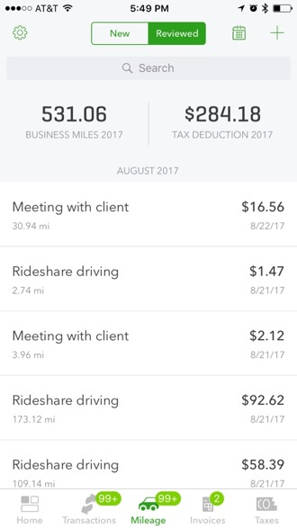
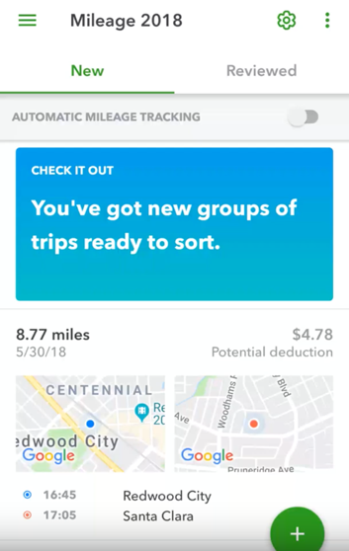
Customers categorize an average of 100 trips/month in significantly less time.
The experience is tailored to a customer’s individual driving patterns.
Before
After
Notes:
BUT, we knew that data science alone wouldn’t deliver a complete product experience.
We went back to the Design for Delight methodology.
Deep Customer Empathy – we interviewed customers in our Lab so we could understand their mental model when reviewing trips.
Rapid Prototyping – we designed and tested prototypes using our customers’ data to gather feedback on how they perceived the idea of “bulk review” of business trips.
In each iteration, we tweaked BOTH our Designs, AND tuned the parameters of the Frequent Pattern Mining algorithm.
We came up with a simple design with a clear call-to-action.
(build) Now it’s easier and faster for customers to identify tax-deductible business trips.

Slide 23
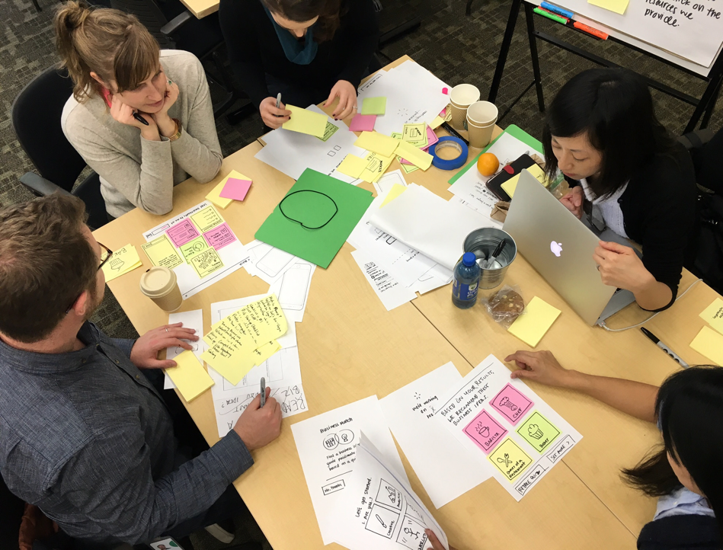
D4D Method: Rapid Experimentation & Paper Prototyping
Rapid prototyping with customers facilitates quick learning and iterations.
A good experiment helps you get past what customers say they would do and discover what they actually do.
Paper or sketch prototyping is an inexpensive way to test ideas early in the process.
Notes:
One of the methods the QuickBooks Self-Employed team used was “Paper Prototyping”
We know that rapid prototyping with customers facilitates quick learning and iterations.
AND a good experiment helps you get past what customers SAY they would do and discover what they actually DO.
Teams often see experimentation as an EXPENSIVE way to prototype, but it doesn’t need to be.
All you need is some paper, sharpies and sticky notes – and some rigor to be clear about what you’re testing, articulate a hypothesis, and define how you’ll assess what you learned.

Slide 24
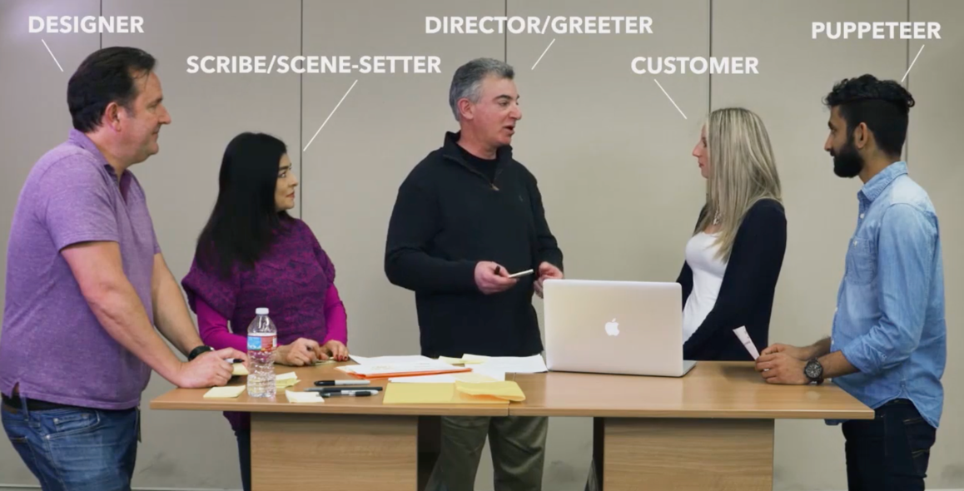
D4D Method: Rapid Experimentation & Paper Prototyping
WARM UP by greeting the customer.
ASK the customer to verbalize their thoughts.
SET THE SCENE where the customer will be using the prototype.
OBSERVE and record the customer’s behavior.
LISTEN for how they’re feeling.
WATCH for surprises.
LET THEM ESCAPE gracefully.
Notes:
Once you’ve sketched out your prototype on paper, go and meet with real customers to see if your hypothesis is valid.
WARM UP by greeting the customer. Help them feel comfortable sharing their thoughts as they use your prototype.
ASK the customer to verbalize their thoughts while interacting with your prototype. But don’t interview them - no talking!
SET THE SCENE where the customer will be using the prototype. Help them understand where and under what circumstances you would expect them to be using this prototype.
OBSERVE and record the customer’s behavior. Not all communication is verbal. Watch body language and facial expressions to gain more understanding.
LISTEN for how they’re feeling. Most people won’t talk about their feelings, so you have to listen between the lines.
WATCH for surprises.
LET THEM ESCAPE gracefully. At each decision point, ensure there is a “no thanks” or other way for them to opt out if that is what they would naturally do.

Slide 25
Standard Deduction vs. Itemized Deduction
Notes:
Our third example blending Design for Delight and Data Science comes from TurboTax. This is a story from a couple of years ago that surprised us!

Slide 26
Problem:
American taxpayers waste time itemizing deductions, only to find that they should take the standard deduction.
TurboTax is able to quickly predict which deduction is right for the customer.
Taxpayers need confidence that they are getting every penny they deserve.
Notes:
For many Americans, the tax refund is their biggest paycheck of the year.
Taxpayers want to be confident that they're getting every penny they deserve.
When preparing taxes, one key decision is whether the tax filer should spend time itemizing deductions, or if they should take the standard deduction.
Filing itemized can be a time consuming process, and the overwhelming majority of tax filers will actually get a BIGGER refund by taking the standard deduction.
TurboTax asks users a few simple questions, and routes them through to the correct path – either standard or itemized.

Slide 27
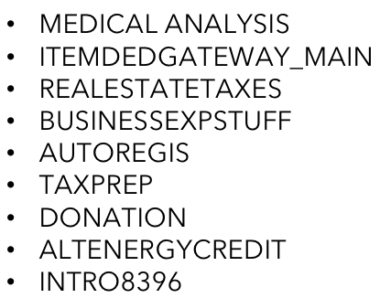
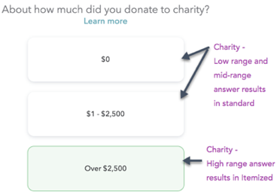
It wasn’t enough to build an SVI deduction prediction model
INPUT:
PTT output
GTKM output
Prev year
PI, SchA,
Income , etc.
ML
Model
Itemized (Baseline) Experience
Itemized
Deduction
SVI Interview
Alternative
Experience
Standard
Deduction
Notes:
We built an ML model that used data from the first part of the tax preparation process.
The model has access to over 600 features and can recommend the standard deduction or itemized deductions with incredible accuracy.
We quickly realized that it wasn’t enough to build a highly accurate tax deduction prediction model.
We thought users would be willing to accept TurboTax’s recommendation. After all, these are the same consumers who are used to seeing recommendations on Amazon, Netflix, or Spotify.
But we discovered that tax filers didn't trust the "instant" answer we gave them.
They didn't think we had enough information about them to make an accurate prediction.

Slide 28
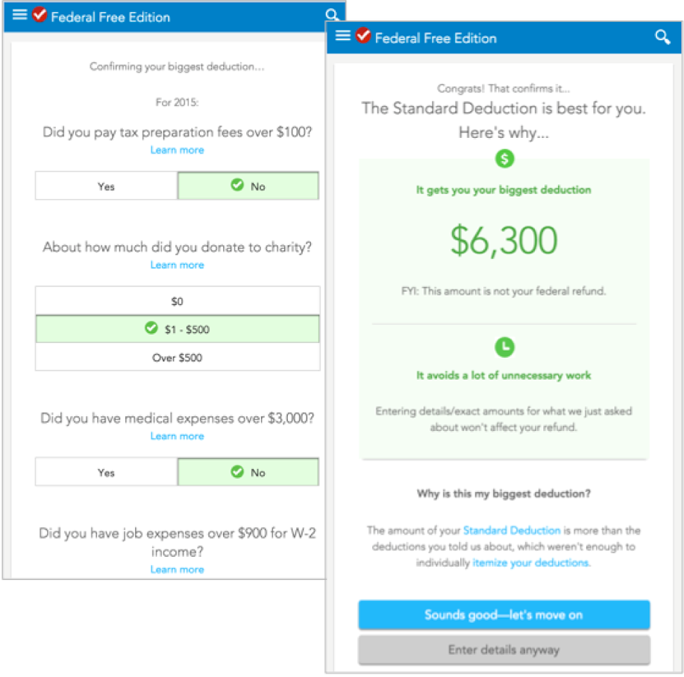
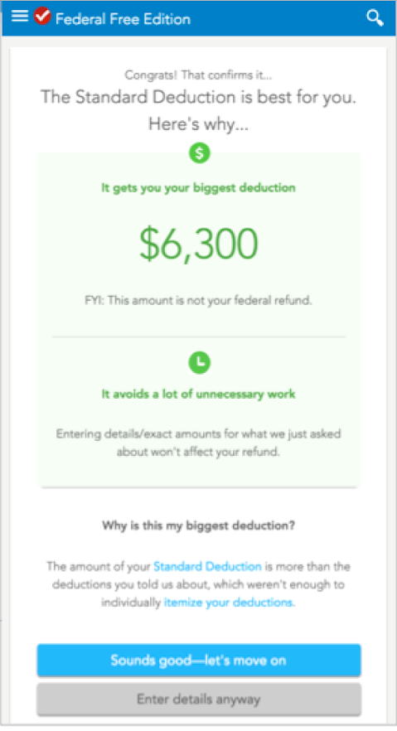
Taxpayers needed us to “show our work”
We estimate that nearly 90% of customers will now take the higher standard deduction when shown this screen.
40% less time spent by taxpayers!
Notes:
We discovered taxpayers wanted to SEE the work without really DOING the work. Through qualitative studies & experimentation we learned that:
Users were most comfortable when providing MORE information than we actually needed to make an accurate recommendation.
(build 1) So, we added a simple, lightweight UI design with few up-front Qs that we knew consumers could easily answer without taking a lot of time.
We gave them a way to provide MORE information without doing a ton of unnecessary data entry.
Altogether, this gave them all the benefits of the new standard vs. itemized feature AND a greater sense of control over the process.
(build 2) This past tax season, we saved our customers almost ½ million hours of tax prep drudgery!
15 million TTO users eligible for SVI model
93% take standard deduction
96% took our recommendation
2 minutes saved on avg
= 446,400 hours of tax prep drudgery

Slide 29
D4D Method: Follow-Me-Home
Find real customers and visit them in their natural habitat (at home or work).
Observe the customer trying to complete a task. Ask them to show you. This is not an interview.
Assume a posture of wonder and curiosity. Don’t judge. Be present and listen actively.
Look for surprises. Insights often come from unexpected or unusual behaviors.
Notes:
One method used by the TurboTax Standard & Itemized deductions team is the Customer Follow-Me-Home.
Observing real behavior is the gold standard for learning what customers care about most. Follow-me-homes are a fast and easy way to observe people experiencing the problems and pains we hope to solve. By observing real behavior, we gain insights, empathy, and shared understanding. We avoid second-hand information which might not be accurate. And we create opportunities to be surprised.
Start by deciding what type of situations or behaviors you wish to learn more about, then identify the customers you will observe. Follow-Me-Homes are most often conducted together as a small working team.
To find real (or potential) customers, reach out to your personal network of friends and family, or simply ask anyone who is your target customer.
Go to where the customer is experiencing the problem. Visit them in their home (ex: consumers), office (ex: small business), or anywhere in their natural habitat.
Set the context, observe and be sure to ask why. The key is to OBSERVE. Remember, this is not an interview.

Slide 30
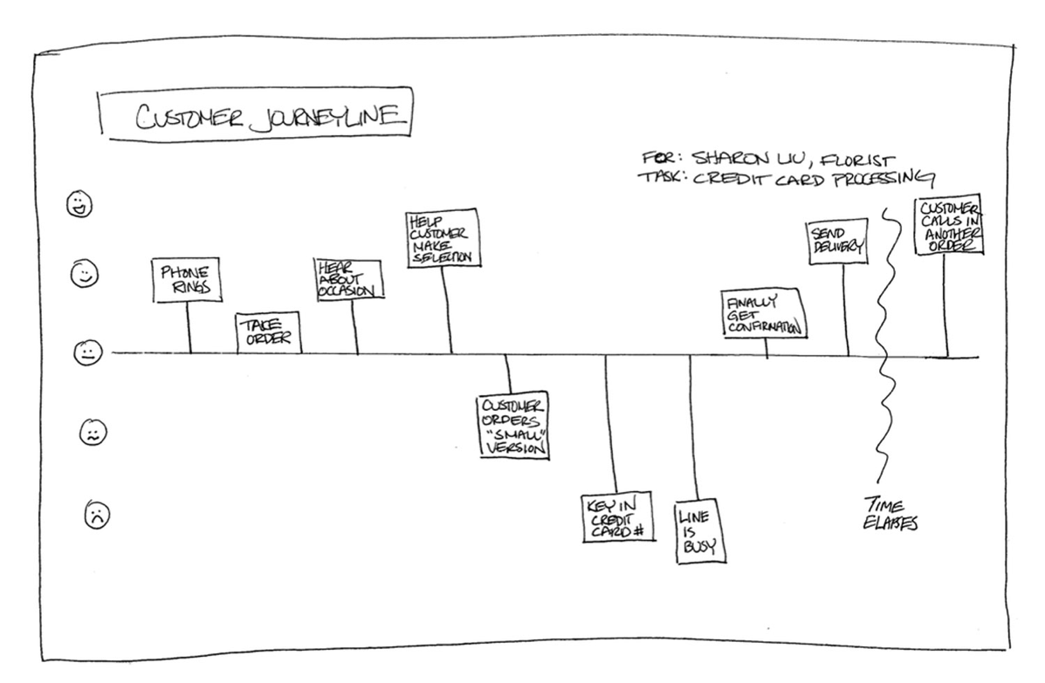
D4D Method: Follow-Me-Home
Create a customer journey line during visit when you need to understand how your customer approaches a task and how they feel about it along the way, including the most delightful — and painful — points.
Debrief with your team. As soon as possible after the session, get together with your team and capture the surprises and pain points you saw.
Notes:
When you need to understand how your customer approaches a task and how they FEEL about it, consider a Journey Line.
A journey line helps you to visualize positive, neutral, and negative emotions over time.
During the follow-me-home, capture the most delightful and painful moments for your customer to deeply understand the problem they are solving and how they solve it today.
Debrief with your team. Share observations, pain points, and surprises.

Slide 31
Data Science & Design mindsets
MODELS
LABELS
PRECISION/RECALL
AUC
K-MEANS
HYPER-PERAMETER TUNING
3-CLICK RULE
GOLDEN RATIO
F-SHAPED PATTERN
WIREFRAME
CARD SORTING
HEATMAP
Notes:
In closing, we’ve looked at three examples of how Intuit blended data science with design thinking to produce AI product features that really work.

Slide 32
Data Science & Design mindsets
MODELS
LABELS
PRECISION/RECALL
AUC
K-MEANS
HYPER-PERAMETER TUNING
3-CLICK RULE
GOLDEN RATIO
F-SHAPED PATTERN
WIREFRAME
CARD SORTING
HEATMAP
CUSTOMER SUCCESS
Notes:
When data scientists and designers come together, and apply the Design Thinking methodology to creatively solve problems, we build products that help power the prosperity of our customers.

Slide 33
Data Science + Design Thinking
CUSTOMER SUCCESS
Deep customer empathy
Go broad to go narrow
Rapid experiments with customers
Notes:
When data scientists and designers come together, and apply the Design Thinking methodology to creatively solve problems, we build products that help power the prosperity of our customers.

Slide 34
Thank you!
@michael_radwin

